Slide 1
What is public Access Modofiers in java?

Slide 2
What is public Access Modofiers in java?
The public keyword is an access modifier, meaning that it is used to set the access level for classes, attributes, methods and constructors

Slide 3
What is private Access Modofiers in java?

Slide 4
What is private Access Modofiers in java?
Private: The private access modifier is specified using the keyword private. The methods or data members declared as private are accessible only within the class in which they are declared

Slide 5
What is protected Access Modofiers in java?

Slide 6
What is protected Access Modofiers in java?
The protected modifier specifies that the member can only be accessed within its own package (as with package-private) and, in addition, by a subclass of its class in another package

Slide 7
What is default Access Modofiers in java?

Slide 8
What is default Access Modofiers in java?
The default access modifier is also called package-private, which means that all members are visible within the same package but aren't accessible from other packages: package com

Slide 9
What is final Access Modofiers in java?

Slide 10
What is final Access Modofiers in java?

Slide 11
What is final Access Modofiers in java?
In Java, variable, method, and class can have a final non-access modifier. The reserved keyword for a final non-access modifier is final . This keyword is used to make any class, method, or variable final. Once a final variable is initialized, you cannot change its value again

Slide 12
What is static Access Modofiers in java?

Slide 13
What is static Access Modofiers in java?
In Java being "static" simply means that there is no object required to access this field/method. "private" is just an access modifier which means that following field/method cannot be accessed outside of its, and can only accessed by this class itself or any inner class.

Slide 14
What is strictfp Access Modofiers in java?

Slide 15
What is strictfp Access Modofiers in java?
java. | strictfp is a keyword in java used for restricting floating-point calculations and ensuring same result on every platform while performing operations in the floating-point variable

Slide 16
What is synchronzed Access Modofiers in java?

Slide 17
What is synchronzed Access Modofiers in java?
The synchronized keyword used to indicate that a method can be accessed by only one thread at a time. The synchronized modifier can be applied with any of the four access level modifiers.

Slide 18
What is native Access Modofiers in java?

Slide 19
What is native Access Modofiers in java?
The native keyword in Java is applied to a method to indicate that the method is implemented in native code using JNI (Java Native Interface). The native keyword is a modifier that is applicable only for methods, and we can't apply it anywhere else

Slide 20
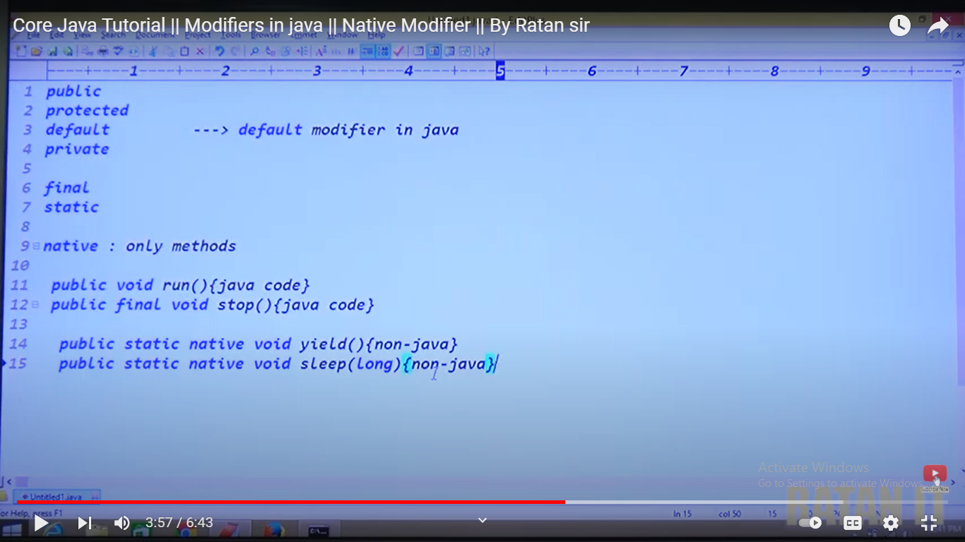

Slide 21
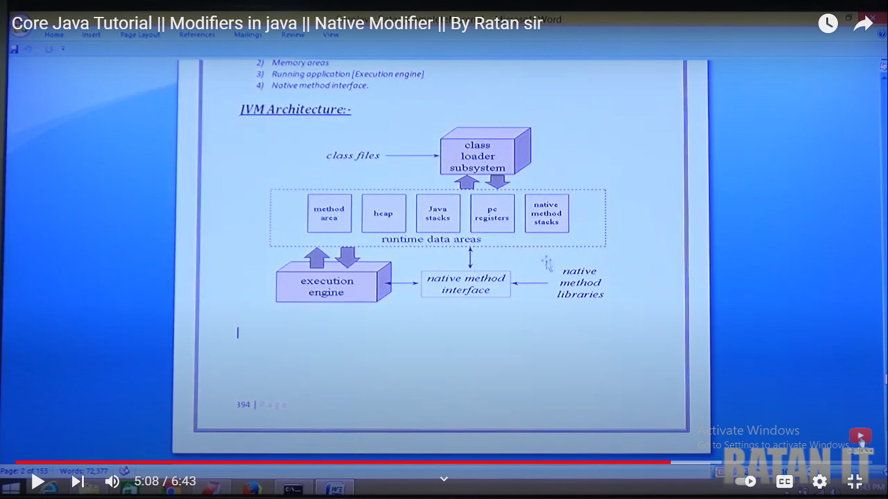

Slide 22
What is transient Access Modofiers in java?

Slide 23
What is transient Access Modofiers in java?
transient is a variables modifier used in serialization. At the time of serialization, if we don't want to save value of a particular variable in a file, then we use transient keyword. When JVM comes across transient keyword, it ignores original value of the variable and save default value of that variable data type.

Slide 24
What is volatile Access Modofiers in java?
transient is a variables modifier used in serialization. At the time of serialization, if we don't want to save value of a particular variable in a file, then we use transient keyword. When JVM comes across transient keyword, it ignores original value of the variable and save default value of that variable data type.

Slide 25
What is volatile Access Modofiers in java?
The volatile modifier is used to let the JVM know that a thread accessing the variable must always merge its own private copy of the variable with the master copy in the memory. Accessing a volatile variable synchronizes all the cached copied of the variables in the main memory

Slide 26
How Many Access Modofiers in java?
12

Slide 27
How Many Access Modofiers in java?
public 10.synchronised
<default> 11.native
Protected 12.abstract
private
Static
final
strictfp
transient
volatile
12

Slide 28
How Many Access Modofiers with respect to class(outter)?
5
Public
<default>
abstract
final
strictfp
5

Slide 29
Strictfp ensures that you get exactly the same results from your floating point calculations on every platform. If you don't use strictfp, the JVM implementation is free to use extra precision where available
strictfp interface sample2 { // methods here will be implicitly strictfp }
strictfp class sample1{ // code here will me implicitly strictfp. }

Slide 30
How Many Access Modofiers with respect to class(inner)?

Slide 31
How Many Access Modofiers with respect to class(inner)?
8
Public
<default>
abstract
final
Strictfp
Static
Private
protected
8

Slide 32
How Many Access Modofiers applicable for method in java?

Slide 33
How Many Access Modofiers applicable for method in java?
public 8.synchronised
<default> 9.native
Protected 10.abstract
private
Static
final
strictfp
10

Slide 34
How Many Access Modofiers applicable for variables in java?

Slide 35
How Many Access Modofiers applicable for variables in java?
public
<default>
Protected
Static
final
transient
Volatile
private
8

Slide 36
How Many Access Modofiers applicable for blocks in java?

Slide 37
How Many Access Modofiers applicable for blocks in java?
static
synchronised
2

Slide 38
Static synchronized methods synchronize on the class object. If one thread is executing a static synchronized method, all other threads trying to execute any static synchronized methods will be blocked. Non-static synchronized methods synchronize on this ie the instance of the class. If one thread is executing a synchronized method, all other threads trying to execute any synchronized methods will be blocked

Slide 39
How Many Access Modofiers with respect to interface(outter)?

Slide 40
How Many Access Modofiers with respect to interface(outter)?
5
Public
<default>
abstract
strictfp
4

Slide 41
How Many Access Modofiers with respect to class(inner)?

Slide 42
How Many Access Modofiers with respect to class(inner)?
public
<default>
abstract
strictfp
static
private
protected
7

Slide 43
How Many Access Modofiers with respect to enum(inner)?

Slide 44
How Many Access Modofiers with respect to enum(inner)?
public
<default>
strictfp

Slide 45
How Many Access Modofiers with respect to enum(inner)?

Slide 46
How Many Access Modofiers with respect to class(inner)?
public
private
protected
<default>
strictfp
static

Slide 47
How Many Access Modofiers with respect to constructor?
public
private
protected
<default>

Slide 48
How Many Access Modofiers with respect to class(inner) but not outter classes?

Slide 49
How Many Access Modofiers with respect to class(inner) but not outter classes?
private
protected
static

Slide 50
Which access modifier is applicable for class but not for inteface

Slide 51
Which access modifier is applicable for class but not for inteface
final

Slide 52
Which access modifier is applicable for class but not for enum

Slide 53
Which access modifier is applicable for class but not for enum
final
abstract

Slide 54
Which access modifier is applicable only for method but anywhere else?

Slide 55
Which access modifier is applicable only for method but anywhere else?
native

Slide 56
The only access modifier used for local variable?

Slide 57
The only access modifier used for local variable?
final

Slide 58
The inteface which is declare inside the class is always?

Slide 59
The inteface which is declare inside the class is always?
Static
Class A
{
static inteface B
{
}
}

Slide 60
The inteface which is declare inside the interface is always?

Slide 61
The inteface which is declare inside the interface is always?
public/static
interface A
{
static inteface B
{
}
}

Slide 62
The class which is declare inside the interface is always?

Slide 63
The class which is declare inside the interface is always?
public/static
interface A
{
static class B
{
}
}

Slide 64
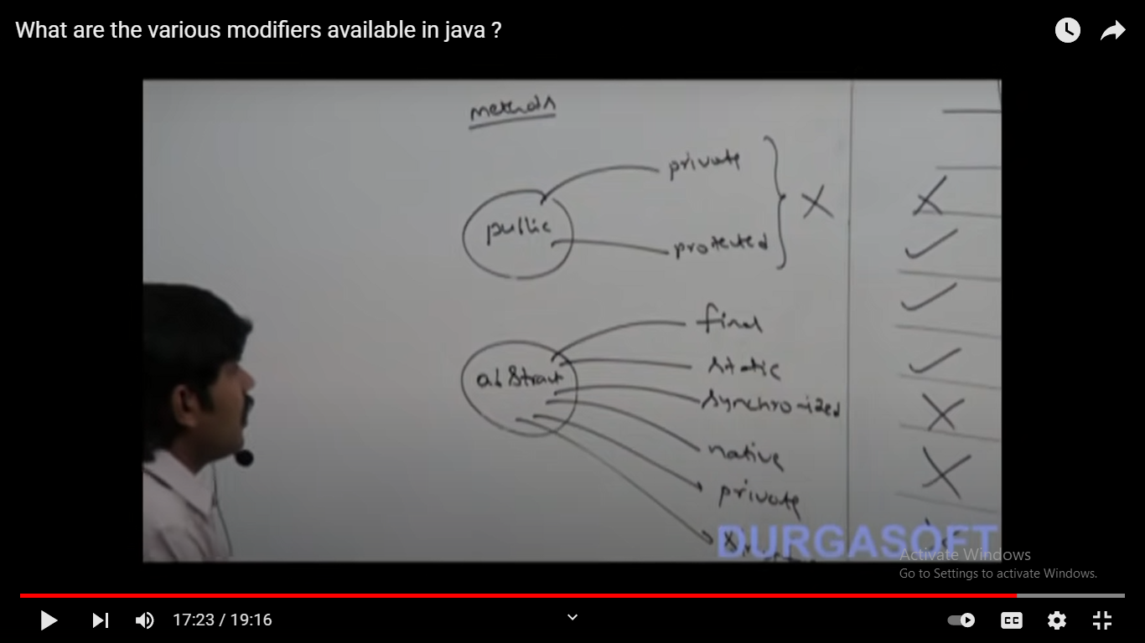
illegal combinations of method

Slide 65
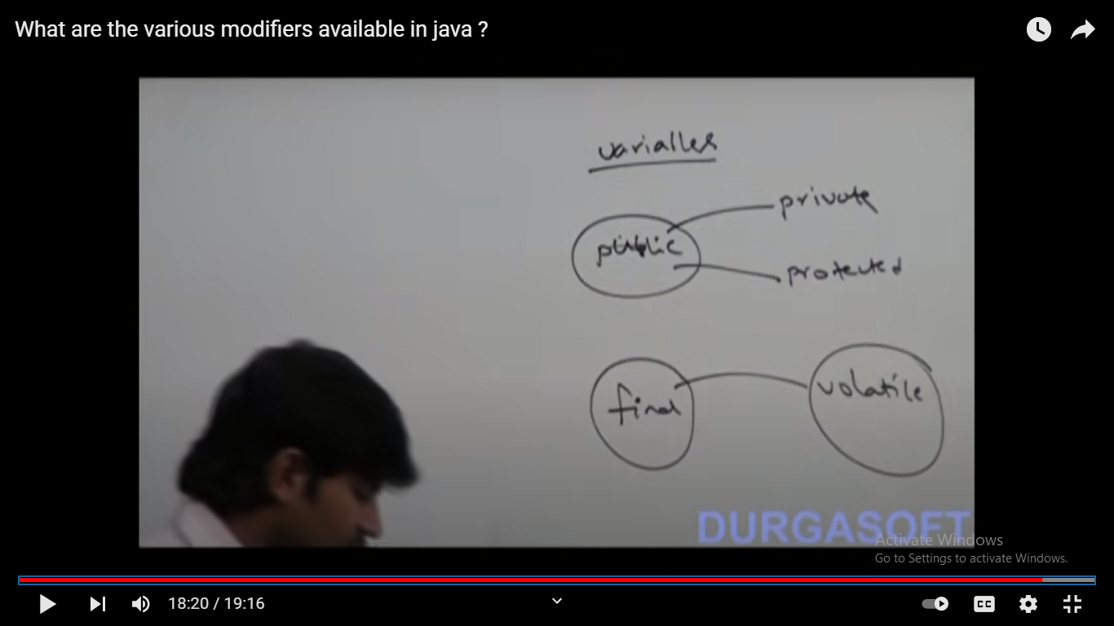
illegal combinations of variables

Slide 66
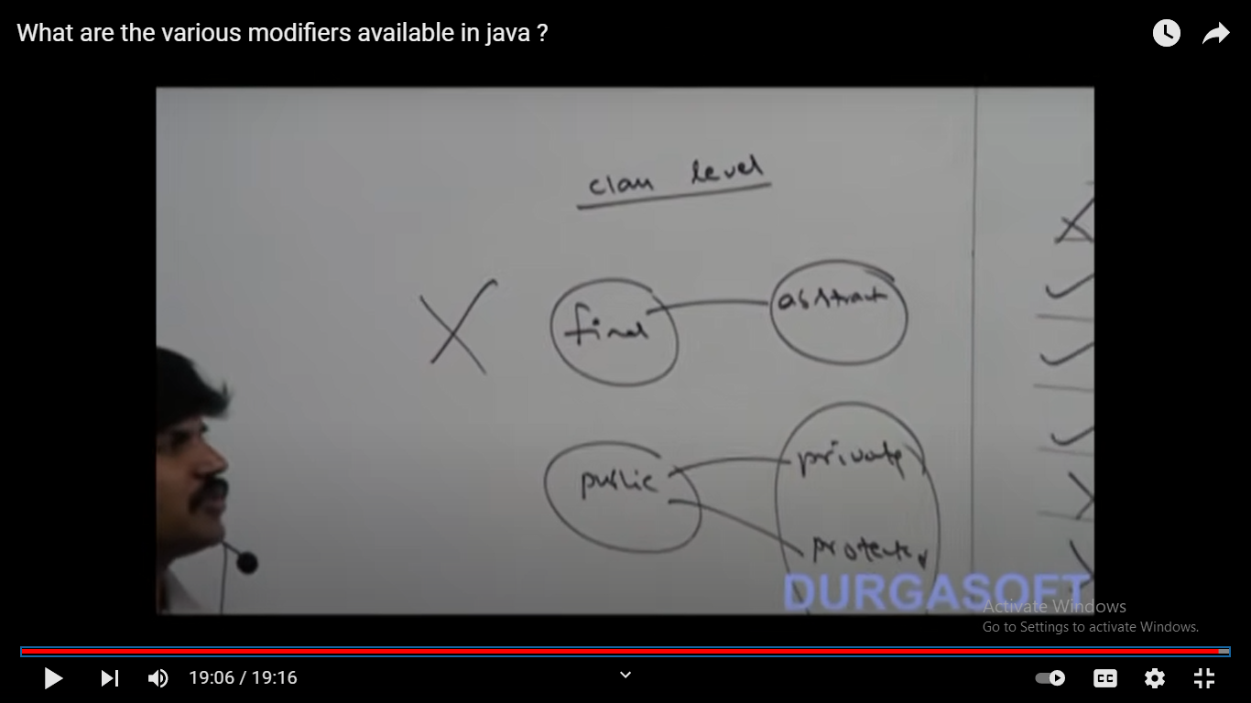
illegal combinations of class

